Slide 1
Computer Vision (Spring 2019) Problem Set #5
Jijun HU
jijun.hu.0930@gatech.edu
Computer Vision @ GT

Slide 2
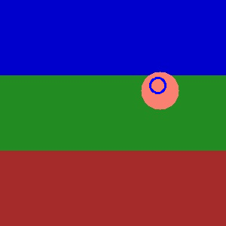
1b: KF Tracking a circle
ps5-1-b-1
Computer Vision @ GT

Slide 3
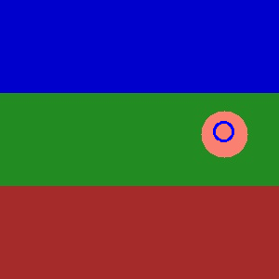
1b: KF Tracking a circle (cont.)
ps5-1-b-2
Computer Vision @ GT

Slide 4
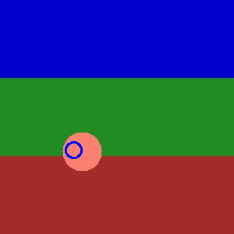
1b: KF Tracking a circle (cont.)
ps5-1-b-3
Computer Vision @ GT

Slide 5
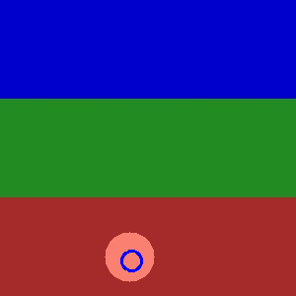
1b: KF Tracking a circle (cont.)
ps5-1-b-4
Computer Vision @ GT

Slide 6
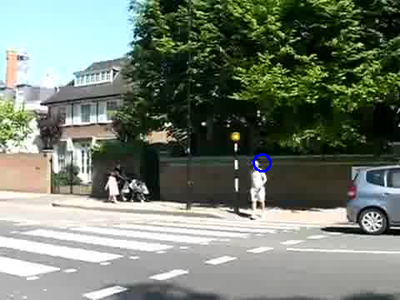
1c: KF Tracking pedestrians
ps5-1-c-1
Computer Vision @ GT

Slide 7
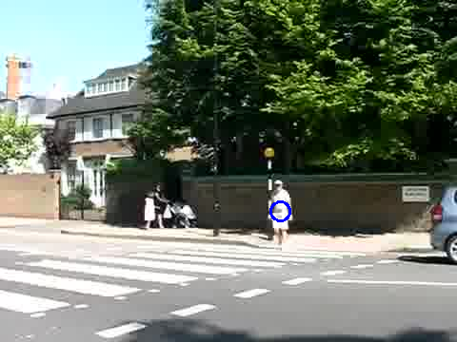
1c: KF Tracking pedestrians
ps5-1-c-2
Computer Vision @ GT

Slide 8
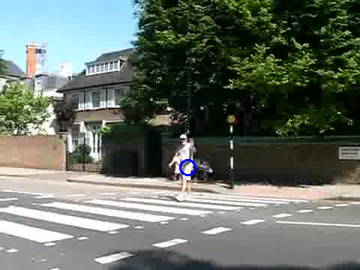
1c: KF Tracking pedestrians
ps5-1-c-3
Computer Vision @ GT

Slide 9
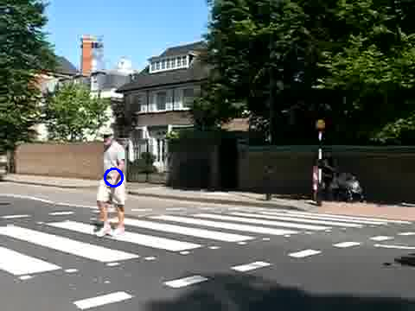
1c: KF Tracking pedestrians
ps5-1-c-4
Computer Vision @ GT

Slide 10
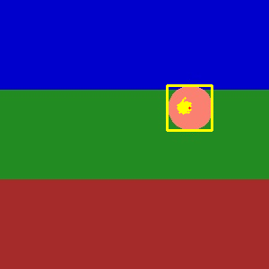
2a: PF Tracking a circle
ps5-2-a-1
Computer Vision @ GT

Slide 11
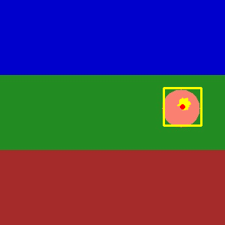
2a: PF Tracking a circle (cont.)
ps5-2-a-2
Computer Vision @ GT

Slide 12
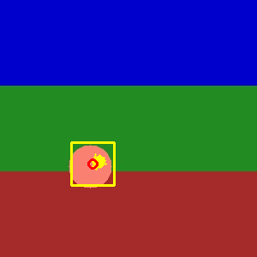
2a: PF Tracking a circle (cont.)
ps5-2-a-3
Computer Vision @ GT

Slide 13

2a: PF Tracking a circle (cont.)
ps5-2-a-4
Computer Vision @ GT

Slide 14
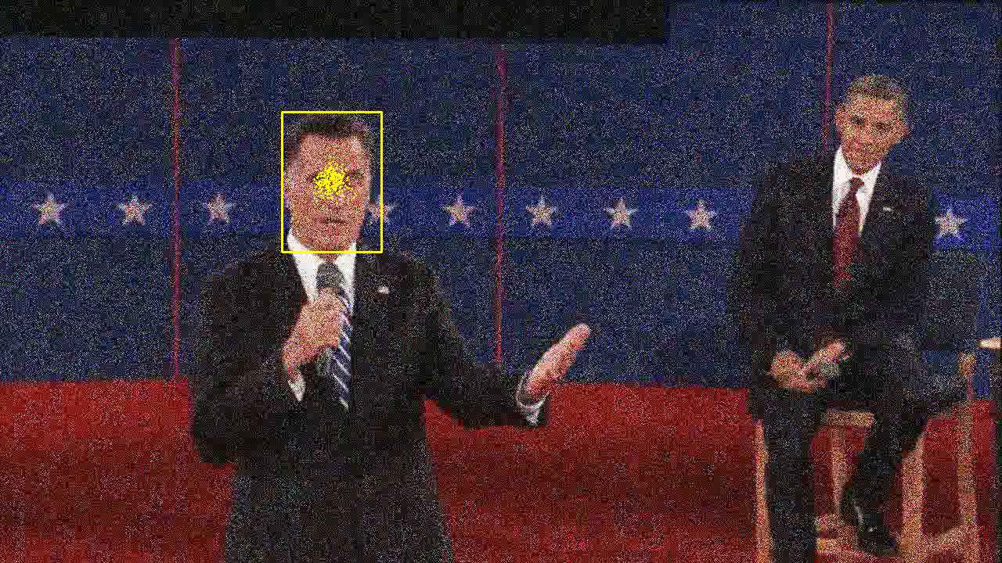
2b: PF Tracking noisy video
ps5-2-b-1
Computer Vision @ GT

Slide 15
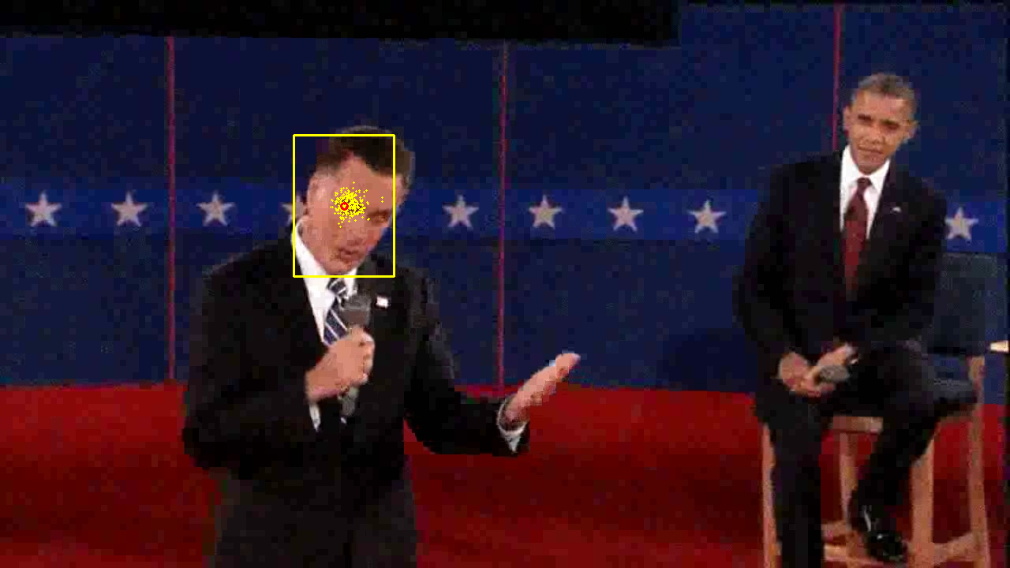
2b: PF Tracking noisy video (cont.)
ps5-2-b-2
Computer Vision @ GT

Slide 16
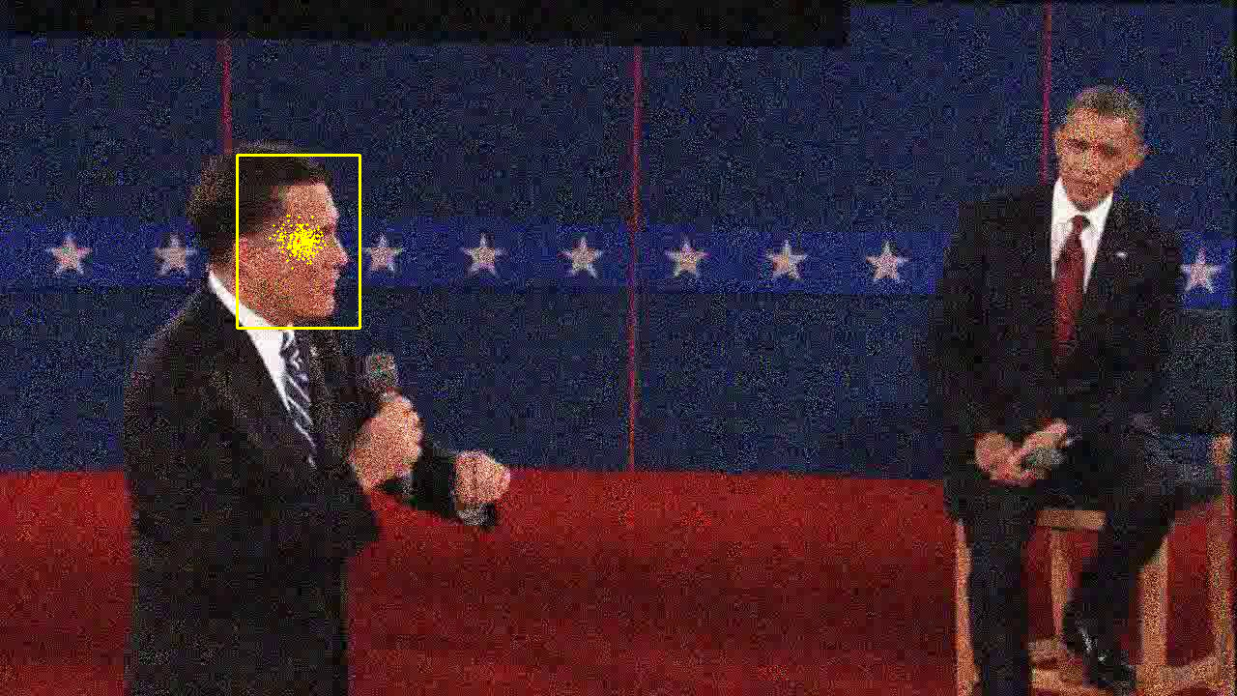
2b: PF Tracking noisy video (cont.)
ps5-2-b-3
Computer Vision @ GT

Slide 17
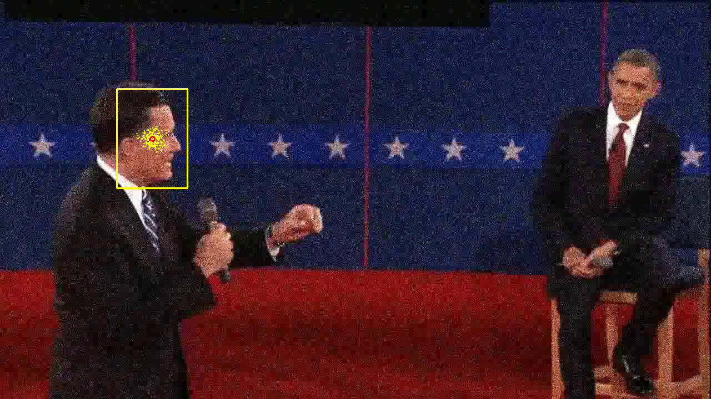
2b: PF Tracking noisy video (cont.)
ps5-2-b-4
Computer Vision @ GT

Slide 18
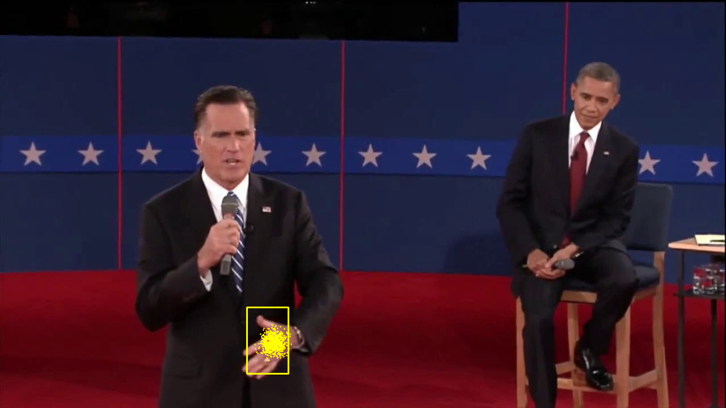
3a: PF Changes in Appearance
ps5-3-a-1
Computer Vision @ GT

Slide 19
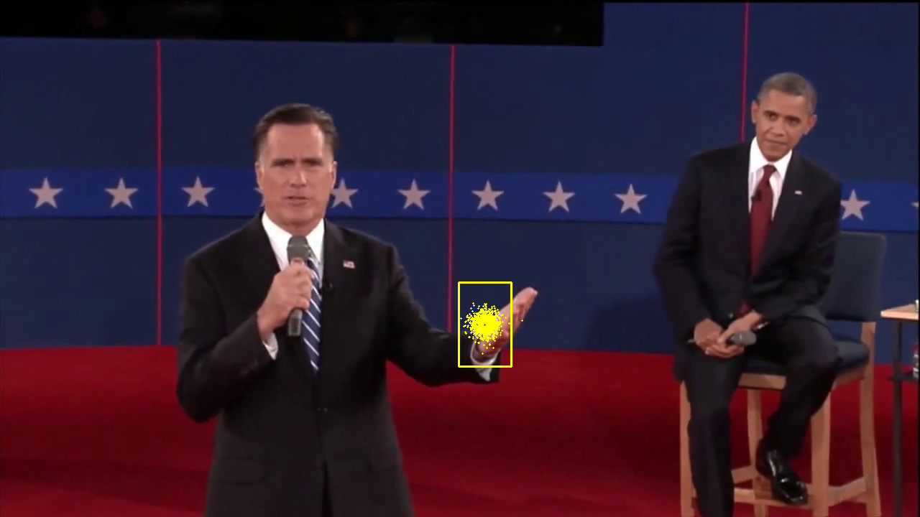
3a: PF Changes in Appearance (cont.)
ps5-3-a-2
Computer Vision @ GT

Slide 20
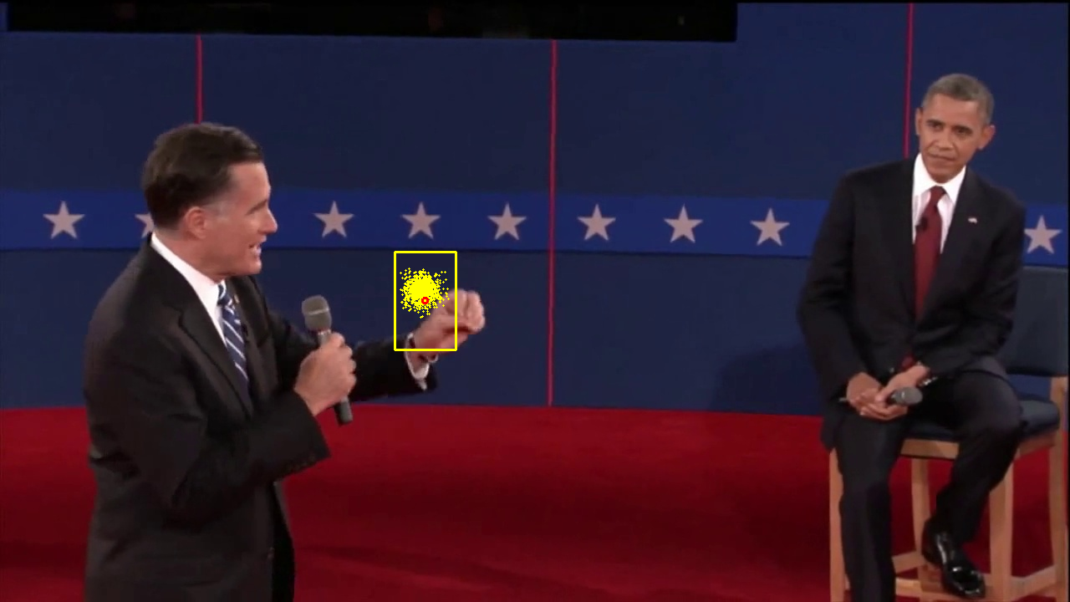
3a: PF Changes in Appearance (cont.)
ps5-3-a-3
Computer Vision @ GT

Slide 21
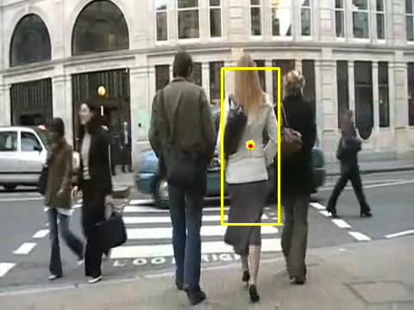
4a: PF Occlusions
ps5-4-a-1
Computer Vision @ GT

Slide 22
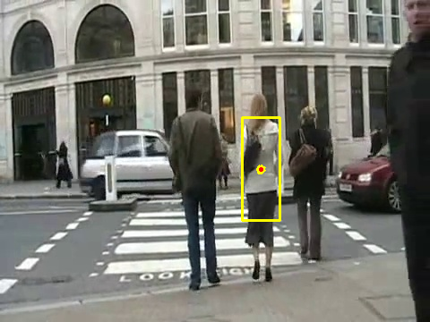
4a: PF Occlusions (cont.)
ps5-4-a-2
Computer Vision @ GT

Slide 23
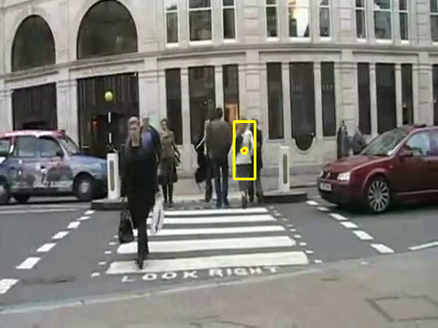
4a: PF Occlusions (cont.)
ps5-4-a-3
Computer Vision @ GT

Slide 24
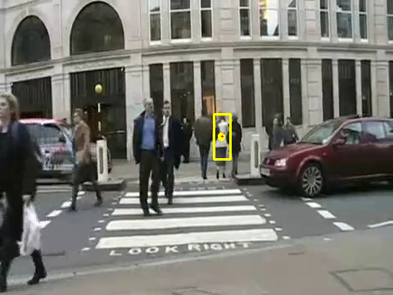
4a: PF Occlusions (cont.)
ps5-4-a-4
Computer Vision @ GT

Slide 25
4: Text response
Describe what you did. How did you modify the Particle Filter class to continue tracking after occlusions?
First I added one more dimension to the particles, called scalar, to adjust the window size. Like what we did for the particle filters, I added some random noise to this scale factor, so this noise will be applied on the dynamics model allowing the scale factor become smaller and smaller. In terms of occlusions, what I did is thresholding, meaning I only run particle filters when the similarity score is larger or equal to my input threshold, or it would keep the parameter as it. Talking about the threshold, what I proposed here is to use the non zero median of all weights of previous iteration.
Computer Vision @ GT

Slide 26
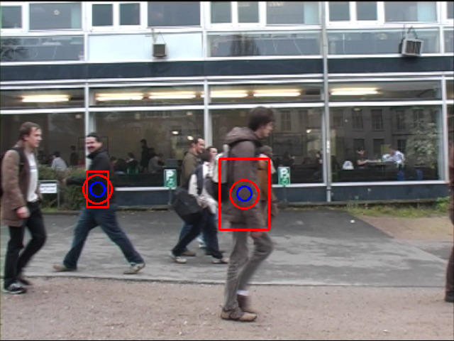
5: Tracking multiple targets
ps5-5-a-1
Computer Vision @ GT

Slide 27
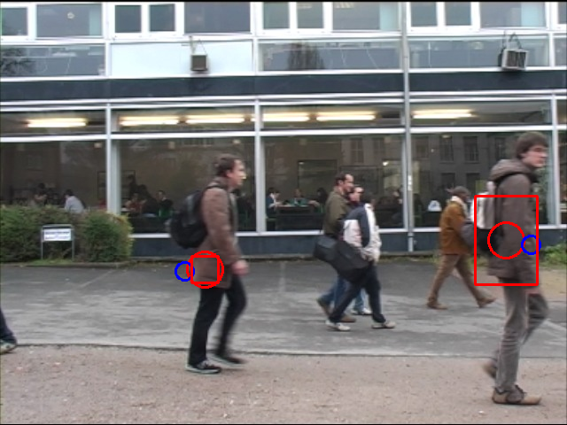
5: Tracking multiple targets (cont.)
ps5-5-a-2
Computer Vision @ GT

Slide 28
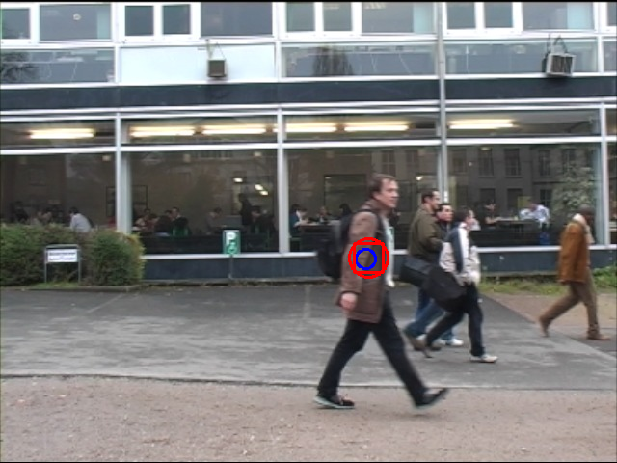
5: Tracking multiple targets (cont.)
ps5-5-a-3
Computer Vision @ GT

Slide 29
5: Text response
Describe what you did. How different it was to use a KF vs PF? Which one worked best and why? Include details about any modifications you had to apply to handle multiple targets.
Based on what I have tried, I think KF works better than PF. I turned the parameters for PF a lot, but still cannot get ideal result.
In terms of working with KF, I did some exploration of all the frames, figuring out all three persons’ entry point and exit point and use them as an input of my tracking inputs’.
Talking about these two models, I feel KF should perform better in this case, cause KF is more like a linear dynamical models with Gaussian noise, which is often optimal to track multiple targets in a relative simple situation, but particle filter is more like a sequential dynamic approach, which is more general and good for complex situations.
Computer Vision @ GT

Slide 30
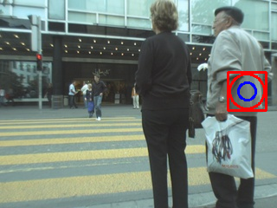
6: Challenge Problem
ps5-6-a-1
Computer Vision @ GT

Slide 31
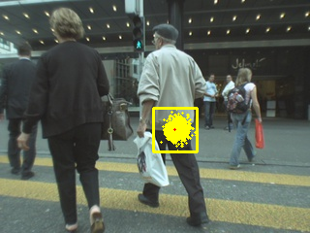
6: Challenge Problem (cont.)
ps5-6-a-2
Computer Vision @ GT

Slide 32
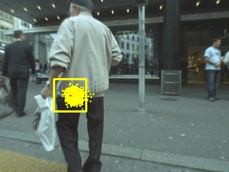
6: Challenge Problem (cont.)
ps5-6-a-3
Computer Vision @ GT

Slide 33
6: Challenge Problem Text response
Describe what you did. Did this task present any additional challenges compared to the previous sections? Include details about any modifications you had to apply.
The idea here is to combine both two method, I tried to run both filter individually and find the KF works good at the beginning while the PF works much better in later situation, so I break the video into two pieces, using KF to track first 60 frames and PF for the rest of them. Also, similar as problem 4, I used thresholding to handle the occlusion situation in the video.
Computer Vision @ GT

